Slide 1
Bellabeat Analysis
File created on: 10/17/2023 6:57:41 PM
Created By: Francis Bajamunde

Slide 2
Background
Business Task: Perform an analysis using data generated from smart device usage and discover patterns and insights for use on Bellabeat Products.
Data used was collected from smart device usage of 33 users from April 12, 2016 to May 12, 2016

Slide 3
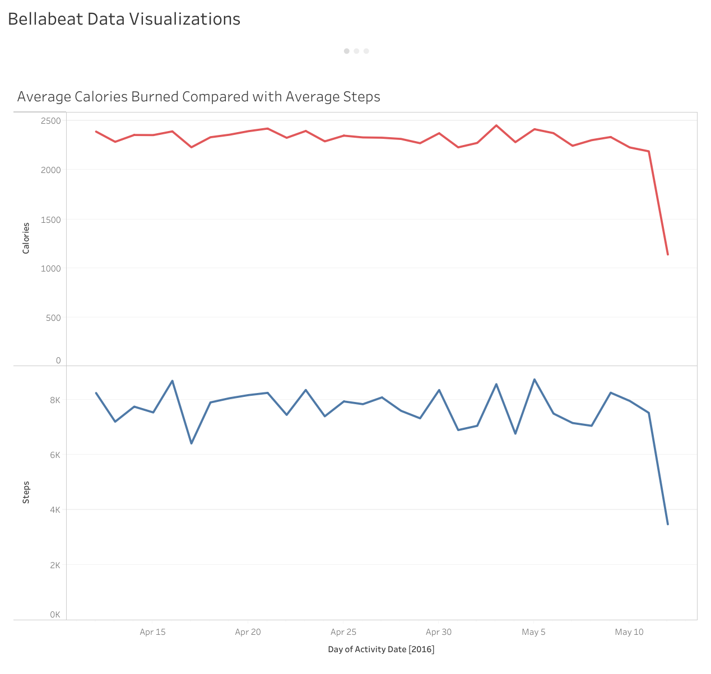
Average Calories burned between all users hovered between 2000 to 2500 Calories.
Average Steps between all users hover roughly between 6000 to 9000 steps.
Insight: Calories burned and step count roughly follow the same pattern of peaks and valleys.
Insight: Over the course of a month, users never surpass 2500 calories on average, or 9000 steps on average.

Slide 4
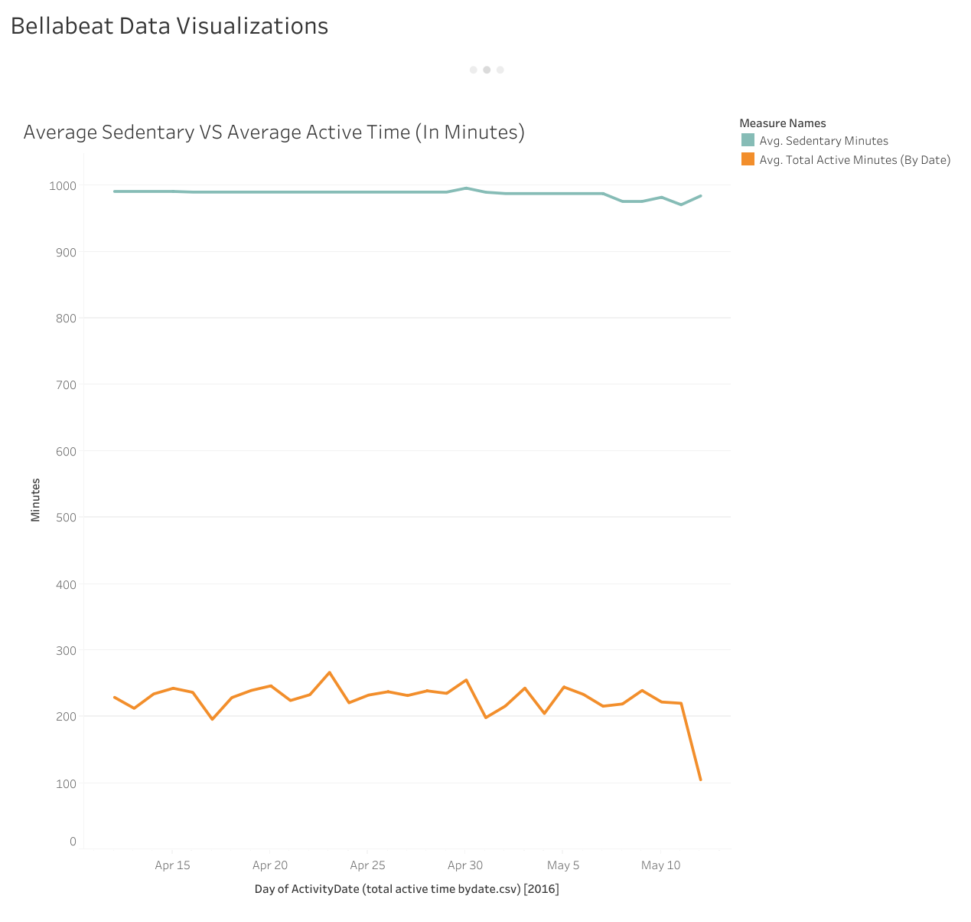
Average Sedentary time between all users stay consistently at 1000 minutes.
Average Active Time between all users stay roughly between 300 and 200 minutes.
Insight: Users spend more time sedentary, than active during the recorded time frame.

Slide 5
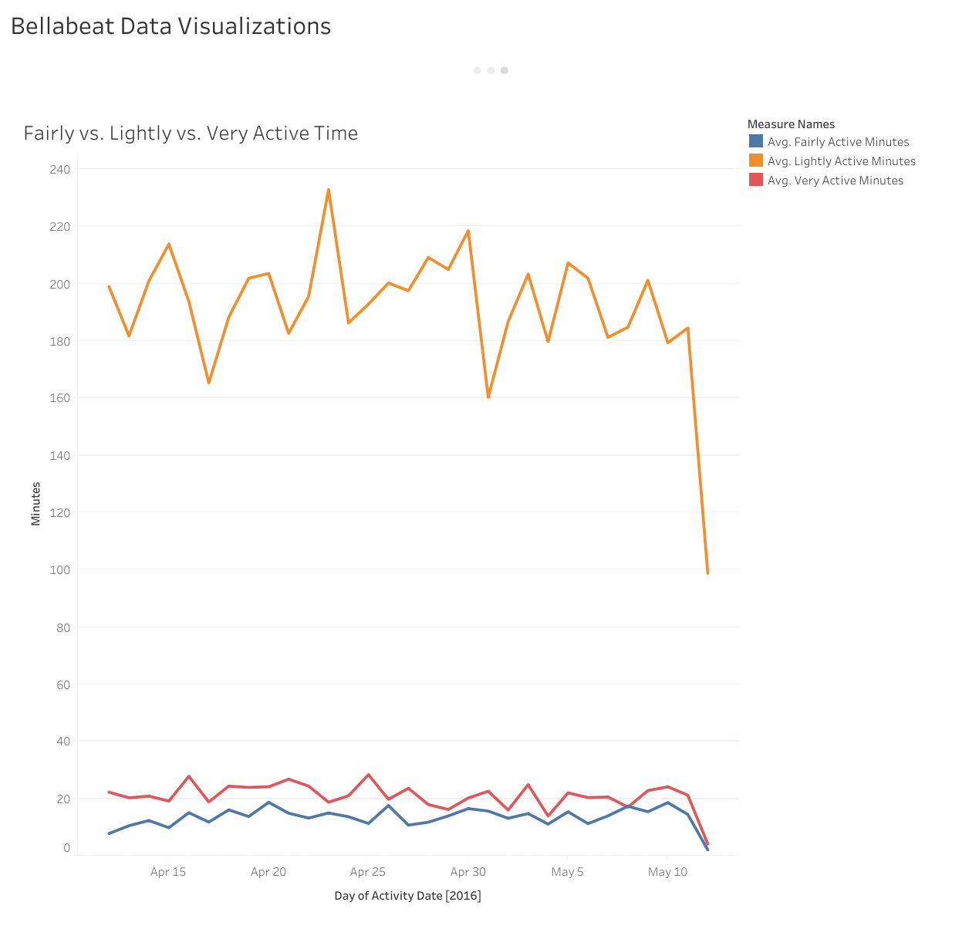
Average Recorded Lightly Active Minutes have a large amount of variation, with values fluctuating between 160 to 240 minutes.
Average Very Active Minutes only slightly surpass Average Fairly Active Minutes.
Very Active Minutes hover between 20 to 30 minutes on average.
Fairly Active Minutes hover between 10 to 20 minutes on average.
Insight: Users spend more time Lightly Active, than Fairly or Very Active.

Slide 6
Analysis
According to Online Sources, adults burn an average of 1300 to 2000 calories a day without working out ^{[1]}.
Average Calories Burned don’t exceed 2500 Calories, only 500 Calories more than the average.
Sedentary Time exceeds active time, while Lightly active minutes exceed both Fairly and Very Active Minutes.
Conclusion: Users don’t use their smart devices primarily for working out, physical activity, or burning calories.

Slide 7
Recommendations
Since users don’t have a tendency to use their smart devices for exercise, emphasis should be placed on making products appealing for daily use.
In this case, the Bellabeat App, Leaf Tracker, and the Time Wellness Watch are the best products to target this consumer need, since they provide a wide range of uses such as tracking health data like activity, stress, and sleep.
Marketing strategy should focus on the variety of features these products have, and how these products can be helpful companions to users in their daily lives.

